Slide 1
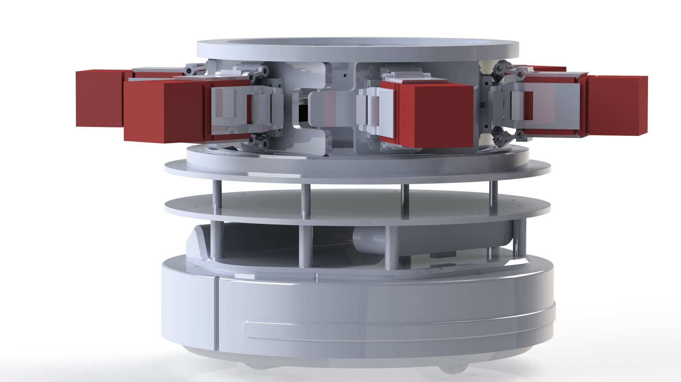
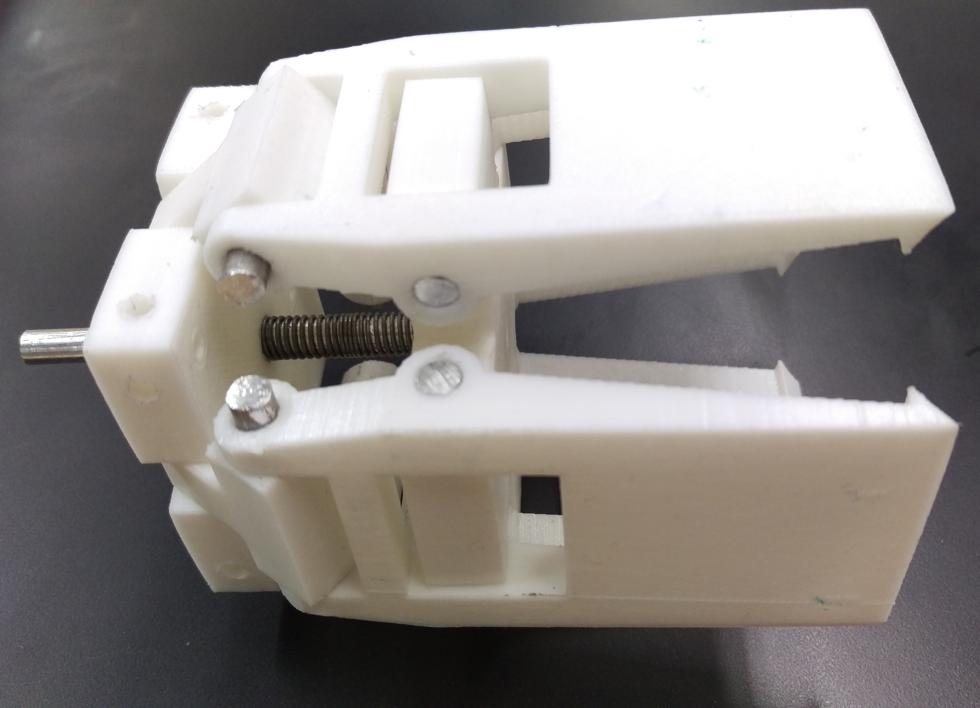
Minor robot logistics 2
Decentralized control
Remco Aarts, Jeroen van den Akker, Robert Delmaar, Bas Janssen, Addie Perenboom, Dimitri Waard
Introduction
Figure 1 – The mechanical design.
Hardware
Figure 2 – The gripper
Software
Logos Ubuntu, ros, etc, link naar github,
References (in APA style)
Nevin, A. (1990). The changing of teacher education special education. Teacher Education and Special Education: The Journal of the Teacher Education Division of the Council for Exceptional Children, 13(3-4), 147-148.
Simmons, B. (2015, January 9). The tale of two Flaccos. Retrieved from http://grantland.com/the-triangle/the-tale-of-two-flaccos/
Correspondence to: Robert Delmaar r.delmaar.student@student.fontys.nl

